Slide 1
Programming For Kids
1805098 - Md. Shahrukh Islam
1805103 - Md. Sohiudul Islam
1805119 - Md. Ahanaf Tahmid

Slide 2
Architecture
Model-View-Controller(MVC)
3 main logical components - Model, View, Controller
Each component handles specific development aspect of our application
Used for designing mobile apps - a plus
What each component will do -
Model : Would interact with database using query and return the results to the controller. So, it handles all of the data
View : If response from database is successful, the View takes the data fetched by the model and render to a format like HTML for the browser
Controller : The middlemen in all interactions. User sends requests to server which is forwarded to the particular controller. Ends the request by returning the presentation generated by View to the user.

Slide 3
System Modules
User Account
Search Module
Course Registration
Course Progression
Course Materials Evaluation
Cornerstone Project
Dashboard Management
Course Recommendation
Archive

Slide 4
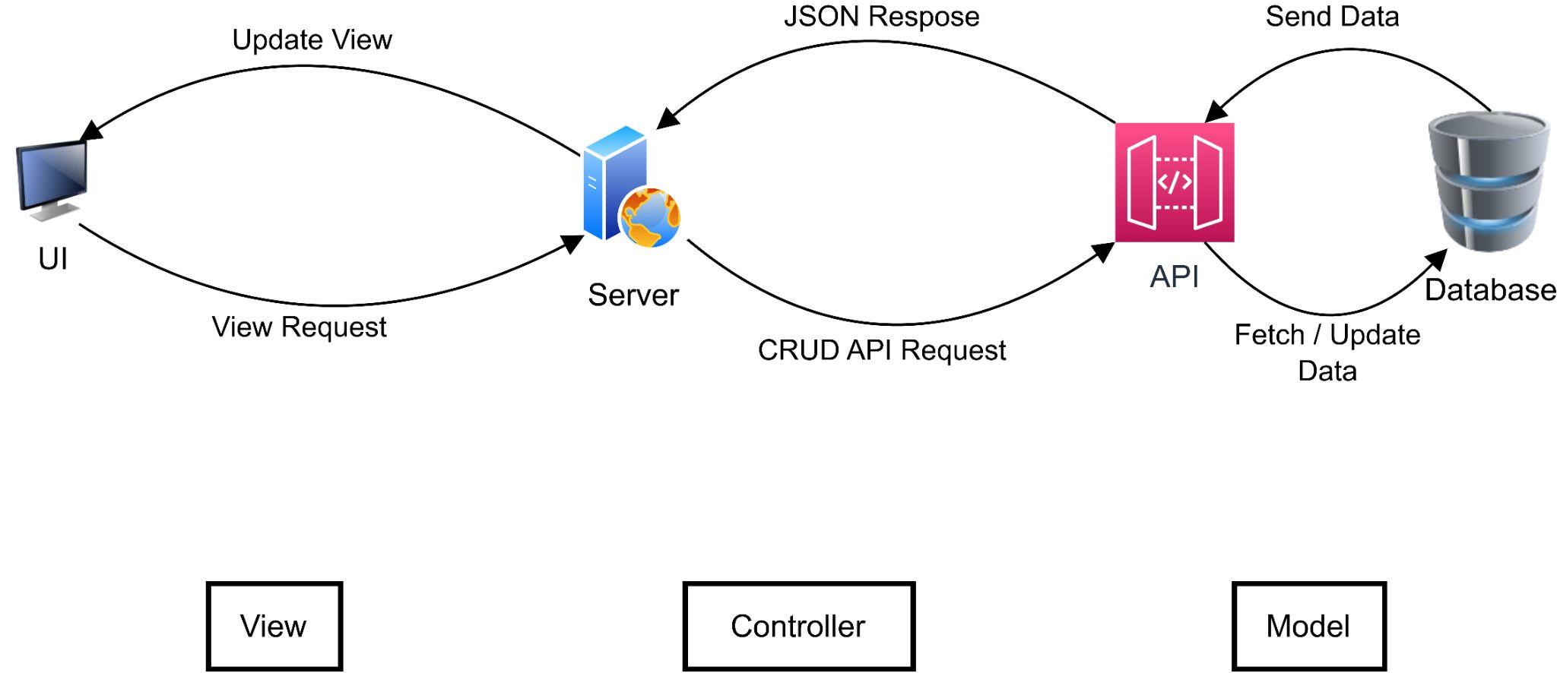
Control Flow

Slide 5
Model Details
Database : PostgreSQL
A few model classes -
Course
User
Course Weekly Content
Reading Materials
MCQs
Programming Problem
Project Steps

Slide 6
View Details
Framework : React.js
A few View Pages -
Landing Page
Registration
Sign-in
Dashboard
Course Details
Learning Content
Problem Description Page ( Programming Problem, Project Step)

Slide 7
Controller Details
Framework
Backend: Django
Frontend: React
Database: PostgreSQL

Slide 8
API Documentation

